Slide 1
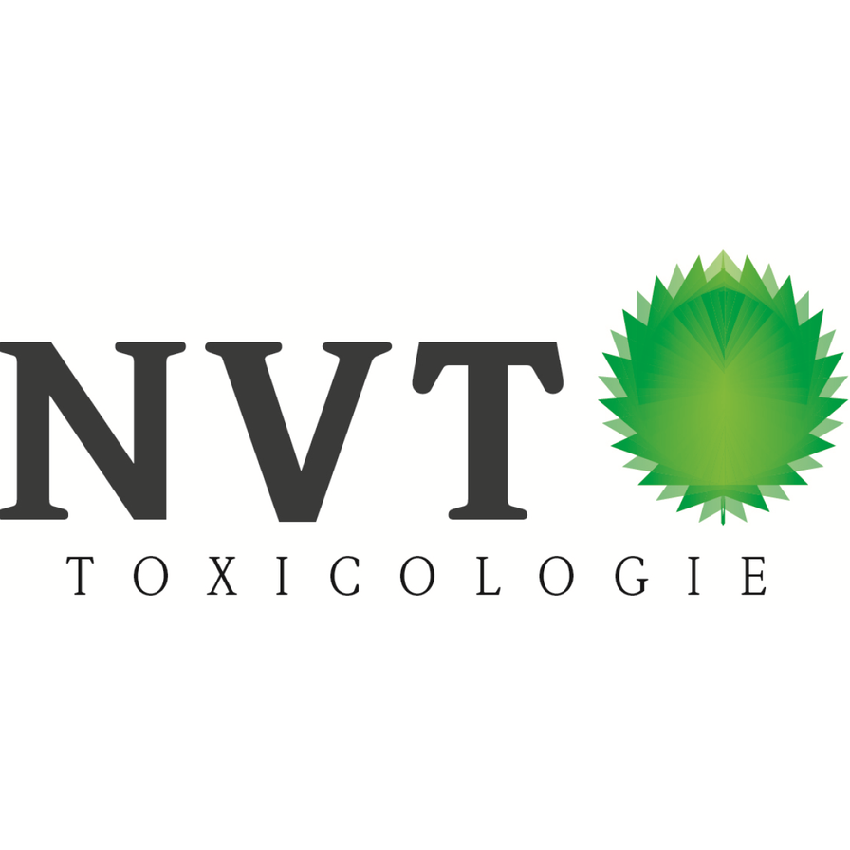
Spring Symposium
14 APRIL 2026
NEW MEDS, NEW CHALLENGES
Location:
Radboudumc
Experience Center
Waalbrug C (route 7)
Address:
Geert Grooteplein Zuid 10,
6525 GA, Nijmegen
NAVIGATING RISKS, INNOVATION, AND SUSTAINABILITY
The landscape of pharmaceutical innovation is rapidly evolving, bringing forward groundbreaking therapeutic modalities while simultaneously introducing new complexities in safety, regulation, and sustainability. As emerging technologies shift the boundaries of what medicines can achieve, they also challenge established frameworks for non‑clinical assessment, environmental protection, and risk management. This symposium, New Meds, New Challenges: Navigating Risks, Innovation, and Sustainability, brings together experts from across the field to explore how science and regulation can keep pace with innovation.
Register NOW!
Due to a maximum capacity of 70 available seats, the registration is on a ‘first-come-first served’ basis.
Registration can be done via: j.meindertsma@rug.nl
Please indicate your name and affiliation.
There will be no charge for attending this symposium. On request, a certificate of attendance will be sent within a few weeks after the event.
Section Pharmaceutical Toxicology

Slide 2
Spring Symposium
NEW MEDS, NEW CHALLENGES
NAVIGATING RISKS, INNOVATION, AND SUSTAINABILITY
Program:
12:00 – 12:30 12:30 – 12:55 | Registration Business meeting – PharmTox section members
12:55 – 13:00 | Opening
13:00 – 13:35 | Presentation 1: Regulatory considerations in non‑clinical development of new medicines. Charlotte de Wolf, DVM, PhD, CBG
13:35 – 14:10 | Presentation 2: Insights in non‑clinical development of AAV gene therapies. Liesbeth Heijink, PhD, ToxWise Nonclinical Consulting
14:10 – 14:30 | Break
14:30 – 15:05 | Presentation 3: Translating non‑clinical findings into clinical safety and labeling for monoclonal antibodies. Loan Honeywell, PhD, Lundbeck
15:05 – 15:40 | Presentation 4: New Meds, and thus also New Safety Assessments? Prof. Mirjam Luijten, PhD, RIVM
15:40 – 16:15 | Presentation 5: Environmental risks of pharmaceuticals: current methods and future developments. Caroline Moermond, PhD, RIVM
16:15 – 16:20 | Closure
16:20 – 17:30 | Drinks & networking
14 APRIL 2026
Location:
Radboudumc
Experience Center
Waalbrug C (route 7)
Address:
Geert Grooteplein Zuid 10,
6525 GA, Nijmegen
Section Pharmaceutical Toxicology

